Slide 1

AMII Machine Learning Technician Course Capstone Presentation
PREDICTING NEW YORK CITY AIRBNB LISTINGS PRICE
November 18th 2022

Slide 2

TEAM INTRODUCTION
Mohammad Parsazadeh • Hadis Ebrahimi • Andrii Shcherbukha
AMII Machine Learning Technician Course Capstone Presentation • November 18th 2022 • Team 5
Notes:
We’re Team # 5, which originally had 5 people, but due to unforeseen circumstances two members of the team had to drop out.
Introduction part (name, occupation, exposure to ML)
We’re using Startrack references because we will be travelling in space and time today.

Slide 3




BUSINESS CASE INTRODUCTION
Since 2008, Airbnb has enabled guests and hosts to experience the world in a unique and personalized manner.
Analyzing the data collected from millions of listings provided by Airbnb and trying to understand the pricing dynamics of the rental market is important for all: Airbnb, hosts, guests.
This analysis can be used for security, business decisions, guiding marketing initiatives, implementing innovative additional services, and many more.
AMII Machine Learning Technician Course Capstone Presentation • November 18th 2022 • Team 5
Notes:
Trying to monitor and understand the underlying pricing dynamics of the rental market is very important for all: Airbnb, its hosts and guests.
As users continue to grow on both the supply and demand side, homeowners may find it hard to properly price their property. Airbnb has recognized this and conducted considerable research into suggesting pricing from a supply side standpoint.
Independent companies like Beyond Pricing and Wheelhouse have emerged to offer dynamic pricing services based on supply/demand, seasonality, local events, time till booking, etc. for rentals including Airbnb.
Although we are probably 10 years late with this project, with better price suggestion estimates, Airbnb home providers can reach an equilibrium price that optimizes profit and affordability.
We seek to analyze almost 50,000 listings in the NYC area in order to better understand how the use of listing attributes such as bedrooms, location, ratings, and more can be used to predict a competitive listing price.

Slide 4
BUSINESS CASE
Question and Research problem:
Airbnb hosts face the challenge of determining the optimal nightly rental price.
Finding a few similar listings and averaging the listed prices can not be used as market is dynamic.
Airbnb provides hosts with general advice, however, there are no easy methods to determine the best price for renting out a space.
Objective:
Developing a regression model to predict the price and identify the factors that have the most influence on the price
AMII Machine Learning Technician Course Capstone Presentation • November 18th 2022 • Team 5

Slide 5


DATA
listing ID
13 additional features
ORIGINAL DATASET FROM KAGGLE: 48,895 rows × 16 columns
FINAL DATASET WITH ADDITIONAL FEATURES 16,769 rows × 29 columns
AMII Machine Learning Technician Course Capstone Presentation • November 18th 2022 • Team 5
Notes:
The original Kaggle (according to the description, originally obtained from InsideAirbnb - scraped data provider) dataset contained a list of all 2019 NYC listings described by 16 features.
After exploring the actual listings on Airbnb we discovered some limitations of the dataset, particularly the missing data on bedrooms/beds/bathrooms/number of people a listing could potentially accommodate. The original dataset was also missing average review score (average and by category). So we developed a script that would use listingID from the original dataset to pull additional information about the listing from airbnb.ca.
Only 16k listings had a match, but we were able to enhance our dataset with 13 additional columns:
Whether host has a “superhost status”
Whether host’s identity been verified
How many people property accommodates
Number of bathrooms
Number of bedrooms
Number of beds
Average review score
Accuracy review score
Cleanliness review score
Check in process review score
Location review score
Communication review score
Value review score

Slide 6

DATA
Background and concerns:
In 2015 Airbnb had introduced a property “Smart Pricing” algorithm that automatically updates a listing's price to match the demand of the market.
New York City has effectively prohibited short-term rentals (less than 30 days) in multi-unit buildings without the owner present since 2011, and made it illegal to even advertise such listings in 2016.
AMII Machine Learning Technician Course Capstone Presentation • November 18th 2022 • Team 5
Notes:
In 2015 Airbnb had introduced a property “Smart Pricing” algorithm that automatically updates a listing's price to match the demand of the market. The dataset description does not state whether the given prices have been adjusted by the algorithm. If that was the case, without knowing the demand and other potential factors that were used for price adjustments, our model might underperform.
New York City has effectively prohibited short-term rentals (less than 30 days) in multi-unit buildings without the owner present since 2011 and made it illegal to even advertise such listings in 2016. Our dataset, however, shows that only 17% of the “Entire apartment/home” category listings had 30+ minimum nights requirement. Perhaps some remaining 83% listings were not active/available for rent, and could have had “old” prices, which also could have impacted our model.
But since the objective of this project was to learn, we did not report those owners to the police ;)

Slide 7
DATA
18%
18%
43%
21%
Location related features
Property physical features
Airbnb listing features
Owner related features
Listing Id
Listing title
Minimum nights
Availability 365
Cleanliness review score
Check in review score
Accuracy review score
Number of reviews
Last review date
Reviews per month
Value review score
Average review score
Host ID
Host Name
Verified Identity
Super Host
Communication review score
Total host listings
Latitude
Longitude
Borough
Neighbourhood
Location review score
Accommodates
Beds
Bathrooms
Bedrooms
Property type
PRICE
AMII Machine Learning Technician Course Capstone Presentation • November 18th 2022 • Team 5
Notes:
The majority of our features described property as an Airbnb listing (like availability, reviews, or minimum nights requirement).
About a third of the features were related to the location and physical characteristics of the property.
And about 20% were related to the owner.

Slide 8
DATA CLEANING AND FEATURE ENGINEERING
Handled missing and improbable data
Handled outliers
Applied log transformation to the target variable
Performed basic exploratory data analysis and removed irrelevant/low impact features and
Normalizing numerical and one-hot encoding categorical features
Performed Feature extraction and checked for multicollinearity
AMII Machine Learning Technician Course Capstone Presentation • November 18th 2022 • Team 5
Notes:
Removed irrelevant/redundant/low impact features e.g. IDs, host name and listing title, borough (we have much granular features like neighbourhoods and coordinates), and total number of reviews (since we have reviews per months feature)
Overall, there was not a lot of missing values in our dataset. Few features (“Verified identity”, “Superhost status”, “Review per months”) had what we determined to be missing at random values, which were imputed with mean values. We also decided to delete datapoints with 0 price and over 31 reviews per months, which seemed unrealistic.
Removed “Last review date” and added “Reviewed in the last 6 months” and “Reviewed in the last 12 month” binary features. Also added new binary “long-term rent” feature based on the minimum nights > 30 condition.
We removed all listings with price over 600 dollars. Our analysis of those listings revealed that they have features like luxury amenities, view, building historic significance that we were not able to capture using the available dataset. 600 dollars threshold was somewhat arbitrary, it was the highest price for a regular hotel room in Manhattan.
Normalizing numerical and applied one-hot encoding categorical features.
To handle the highly skewed distribution of our target variable, we applied a log transformation.

Slide 9
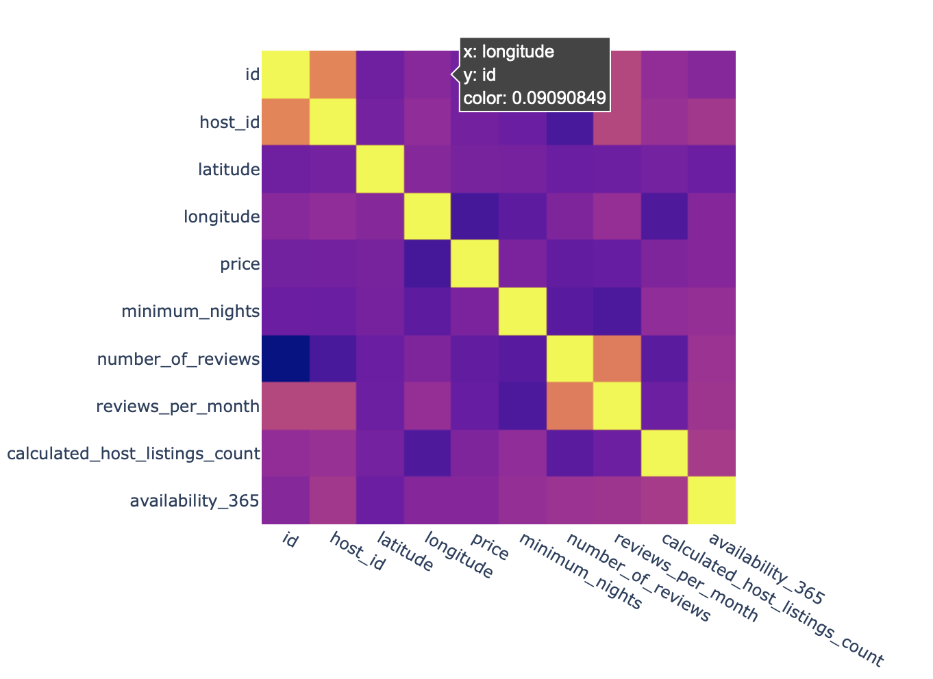
CHECKING FOR MULTICOLLINEARITY
AMII Machine Learning Technician Course Capstone Presentation • November 18th 2022 • Team 5

Slide 10
DATA
91%
3%
4%
2%
Location related features
Property physical features
Airbnb listing features
Owner related features
Minimum nights
Availability 365
Cleanliness review score
Check in review score
Accuracy review score
Reviews per month
Value review score
Average review score
Reviewed in last 6 months
Reviewed in last 12 months
Verified Identity
Super Host
Communication review score
Total host listings
Latitude
Longitude
Location review score
221 feature representing neighbourhood
Accommodates
Beds
Bathrooms
Bedrooms
3 Property type features
PRICE
AMII Machine Learning Technician Course Capstone Presentation • November 18th 2022 • Team 5
Notes:
Now with 221 additional columns representing each neighbourhood, our location related columns represent the dominating majority of features.

Slide 11

METHODS
 | Performance on the test dataset
Methods | Mean Absolute Error | Root Mean Squared Error | Coefficient of determination (R²)
Linear Regression | 35.1 | 57.1 | 0.56
Ridge Regression | 35.1 | 56.8 | 0.57
Lasso Regression | 35.2 | 57.1 | 0.56
K Neighbors Regression | 37.8 | 61.6 | 0.49
Decision Tree Regression | 37.7 | 61.8 | 0.49
Random Forest Regression | 31.4 | 50.9 | 0.65
AMII Machine Learning Technician Course Capstone Presentation • November 18th 2022 • Team 5
Notes:
We tried a few popular ML methods and decided to proceed with the Random Forest which yielded the most promising performance.

Slide 12

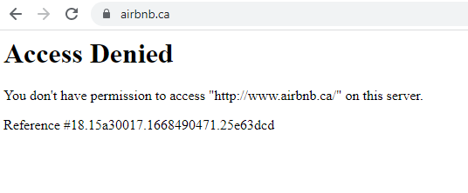
RESULTS
AMII Machine Learning Technician Course Capstone Presentation • November 18th 2022 • Team 5

Slide 13
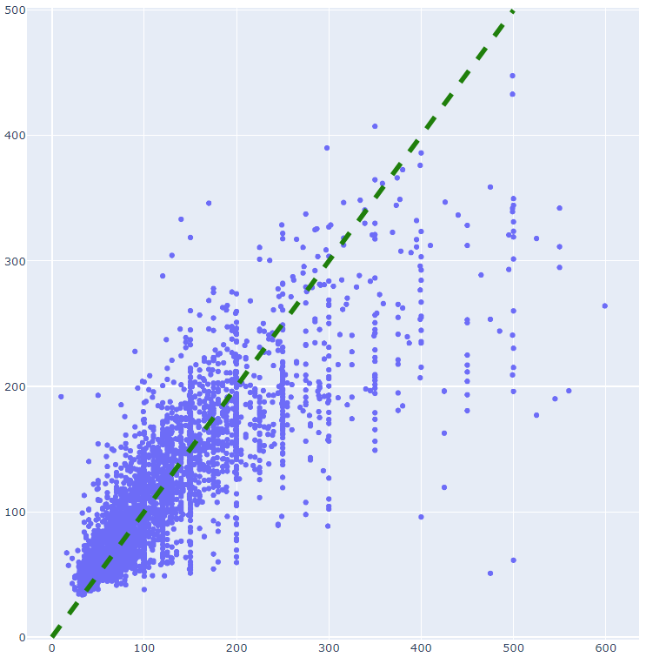
RESULTS
predicted price
actual price
AMII Machine Learning Technician Course Capstone Presentation • November 18th 2022 • Team 5

Slide 14
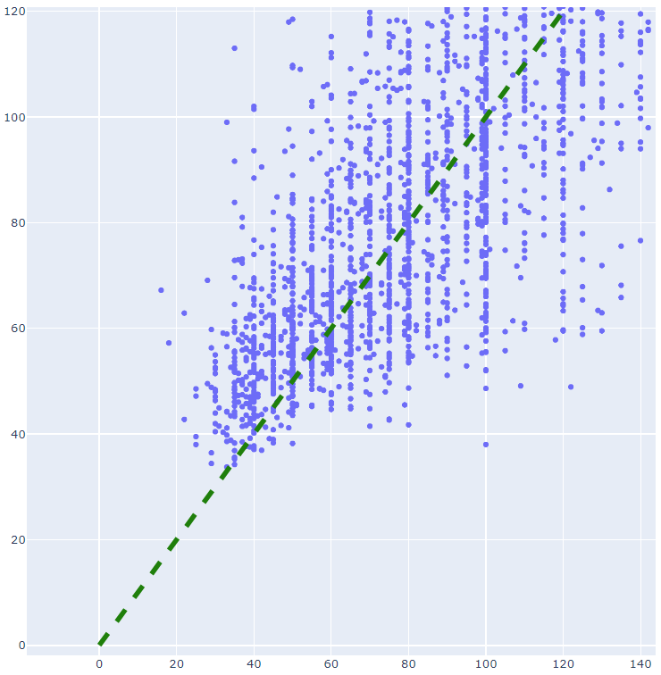
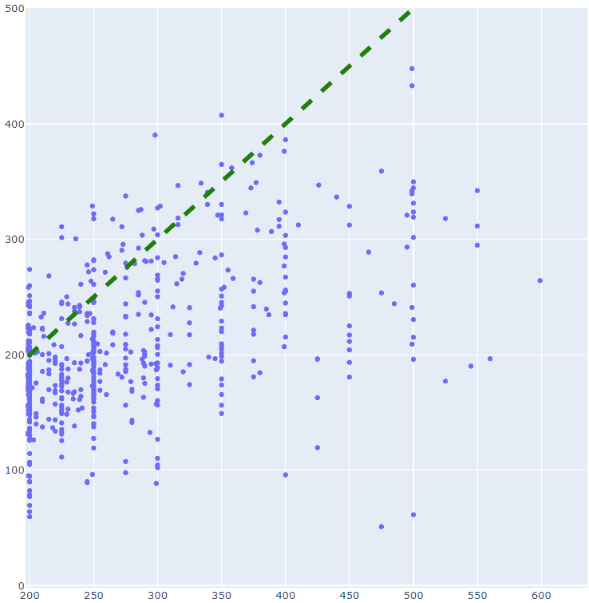
RESULTS
predicted price
predicted price
actual price
actual price
actual price
AMII Machine Learning Technician Course Capstone Presentation • November 18th 2022 • Team 5

Slide 15
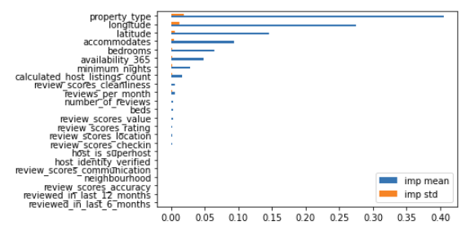
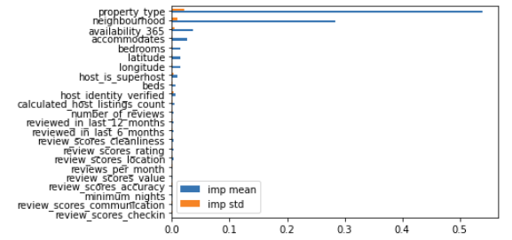
RESULTS
permutation importance for
random forest model
permutation importance for
k neighbors regression model
AMII Machine Learning Technician Course Capstone Presentation • November 18th 2022 • Team 5
Notes:
So one of the questions was why did random forest outperformed the rest.
By nature random forests are less prone to overfitting. They also have a build in feature importance mechanism that was able to pick up what seem like the most important features.
Permutation shows how much model performance decreased with a random shuffling.

Slide 16

RECOMMENDATIONS FOR PERFORMANCE IMPROVEMENT
Hyperparameter tuning for the random forest method (grid-searching over the parameters was launched 24 hours ago and still has not finished).
Trying geographical random forests (a spatial extension of the random forest algorithm) and other ensemble algorithms.
Using feature importance determined by random forest as weights in kNN regressor.
Adding more features related to the property (e.g. list of amenities) and the surrounding area (top rated attractions, places of interest located nearby).
Implementing co-occurrence and clustering analysis (unsupervised ML models) may find the correlation and association between the words, and extract the hidden information in the reviews and listing description.
AMII Machine Learning Technician Course Capstone Presentation • November 18th 2022 • Team 5

Slide 17
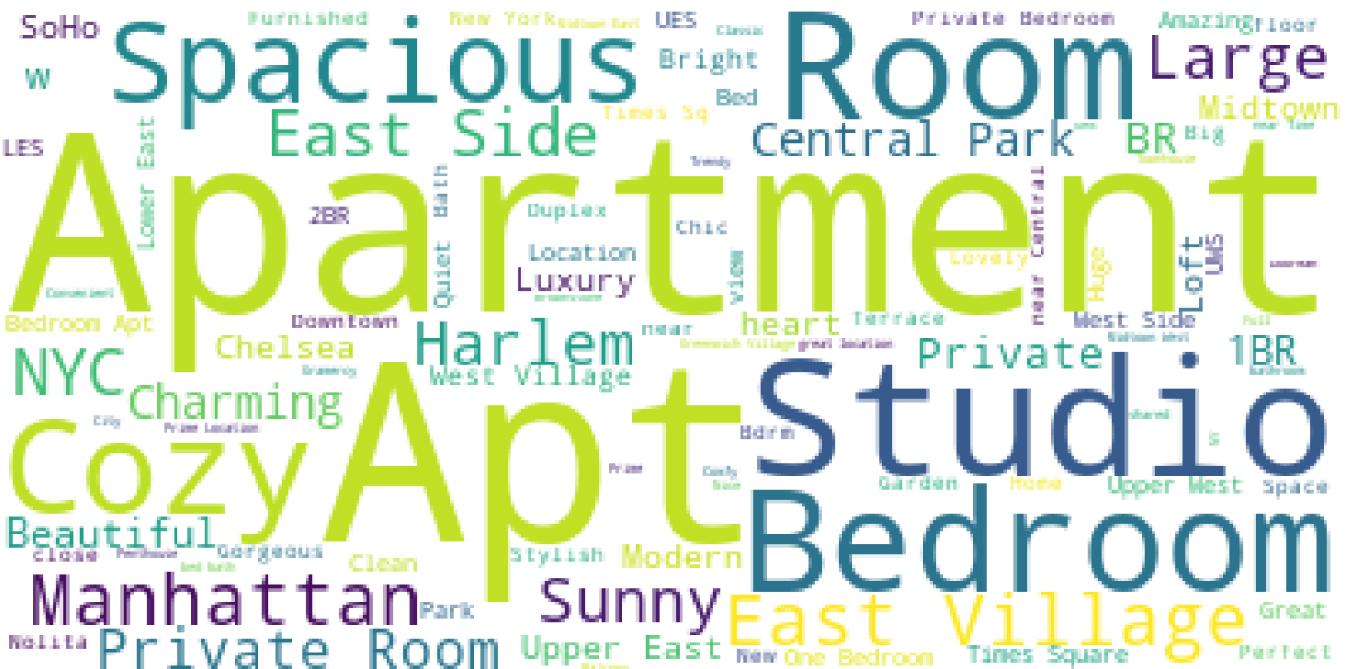
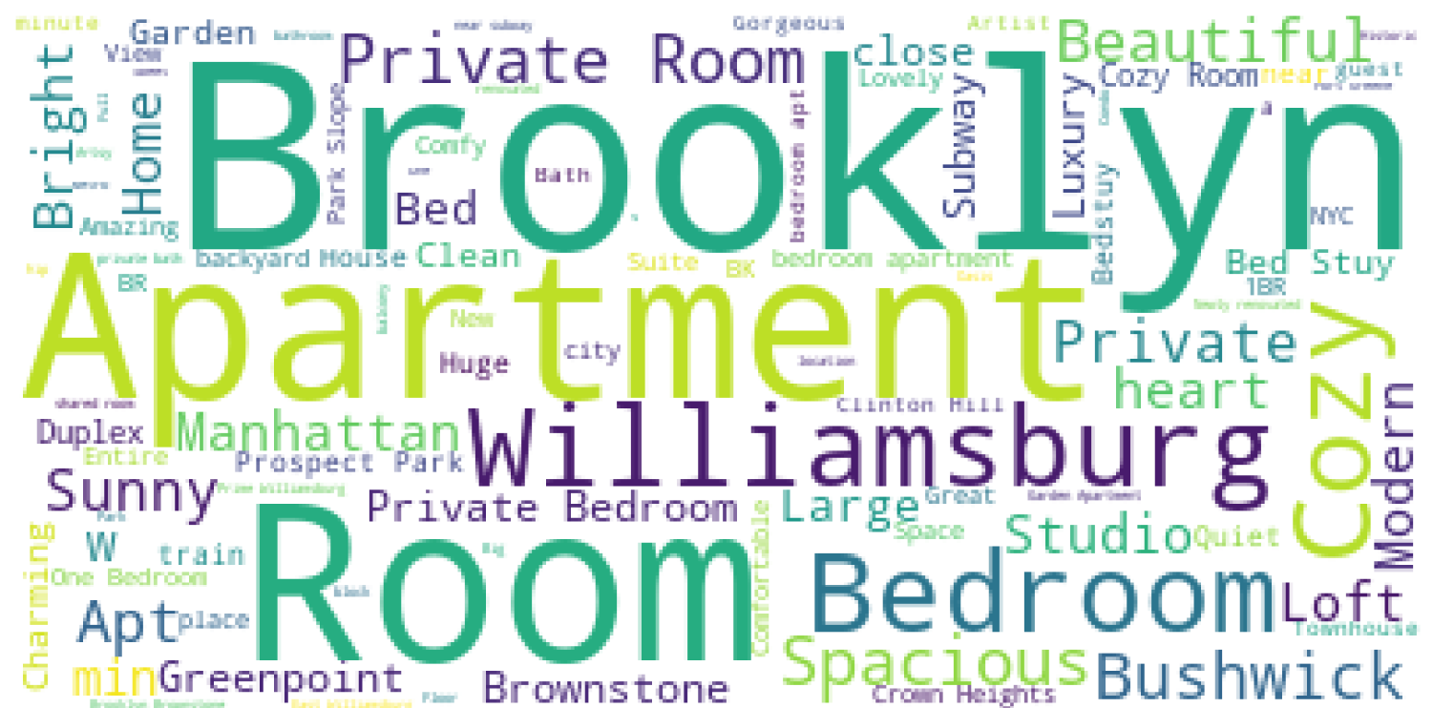
LISTING TITLES WORD CLOUD
Manhattan
Brooklyn
AMII Machine Learning Technician Course Capstone Presentation • November 18th 2022 • Team 5
Notes:
Regardless of the type of listing(Apt or private room), it seems that the listing on Manhattan had more focus on words like “large” “spacious” than the Brooklyn listings. Manhattan listings had more focus on “central park” but Brooklyn listings focused on Williamsburg neighbourhood.
Later on, we could evaluate if there is any association between these words and price or occupancy rate

Slide 18

BACK TO THE BUSINESS VALUE
The ability to accurately determine which characteristics of the property impact the market price the most can help maximize owner revenue.
Another potential application would be a tool that allows to evaluate properties available for sale based on their short-term rent perspective and suggest a potential ROI.
This project could have been where the development of such models started a decade ago.
Be mindful of the potential adverse reactions!
As of April 2022 New York had more Airbnb listings than apartments for rent.
Before the introduction of “Smart Pricing” tool, white hosts were earning $12.16 more than black hosts; algorithm’s effect on hosts who did not adopt the algorithm, mostly black hosts, increased the gap.
The untapped market so far is tools for finding underestimated listings that would potentially allow customers to save money while enjoying the experience they seek.
AMII Machine Learning Technician Course Capstone Presentation • November 18th 2022 • Team 5
Notes:
The ability to accurately determine which characteristics of the property impact the market price the most can help maximize owner profit and ROI. The hosts, Airbnb and third-party companies like companies Beyond Pricing and Wheelhouse would and have been financially benefiting from it.
Another potential application would be a tool that allows to evaluate properties available for sale based on their short-term rent perspective and suggest a potential ROI. Applications like that also already have been implemented.
This project could have been where the development of such models started a decade ago. That’s why We used the startreck references - we had to travelin in space and time.
Critics say that Airbnb’s business model makes homes unaffordable in large cities that are attractive for tourists.
Research conducted by the Harvard Business Review across the US found that Airbnb is having a detrimental impact on housing stock as it encourages landlords to move their properties out of the long-term rental and for-sale markets and into the short-term rental market.
current market shortage: as of April 2022 New York had more Airbnb listings (11k, according to AirDNA, and 20k according to Inside Airbnb) than apartments for rent (8k). A lot of the owners realized they could maximize their ROIs by switching between short and long-term renting approaches or using Airbnb to find long-term tenants.
Another U.S. study found that a 1% increase in Airbnb listings leads to a 0.018% increase in rents and a 0.026% increase in house prices.
The untapped market so far is tools for finding underestimated listings that would potentially allow customers to save money while enjoying the experience they seek.

Slide 19
THANK YOU!
AMII Machine Learning Technician Course Capstone Presentation • November 18th 2022 • Team 5

